Slide 1
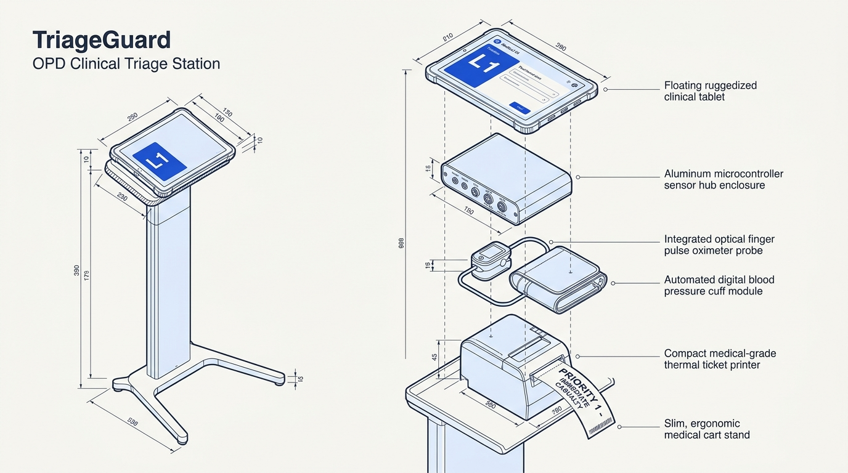

TALENTAP MEGA HACKATHON 2026 · PROBLEM H1
TriageGuard
AI-powered emergency triage and routing for overloaded government OPDs.
“We built the system that decides who lives first.”
RONIN LABS · TEAM 001254
LEAD: ANUDEEP GEDELA R S
SUB-15MS EDGE INFERENCE · ASYMMETRIC SAFETY
Notes:
Introduce TriageGuard, developed by Ronin Labs for TalentAP Mega Hackathon 2026 under Problem H1. Focus on the core engineering thesis: replacing blind arrival queues in overburdened government OPDs with deterministic clinical safety rules and conformal AI running in under 15 milliseconds on local hardware.

Slide 2
Arrival order can hide clinical danger
CASUALTY QUEUE CRISIS
REPORTED TERTIARY OPD METRICS
First-Come, First-Served (FCFS) ignores physiological risk. A walking patient with uncomplicated conjunctivitis is processed before a silent myocardial infarction sitting quietly in the back row.
15,000+
< 90 s
DAILY OPD FOOTFALL PER TERTIARY FACILITY
AVERAGE NURSE FACE-TIME PER INTAKE
15–20%
58%
ILLUSTRATIVE CLINICAL CASE
Rajesh, 54, acute chest pain: Waited 78 minutes behind 40 non-acute outpatients in a standard FIFO registration queue and died. Arrival timestamps cannot measure myocardial ischemia.
SOURCE-ESTIMATED BASELINE UNDER-TRIAGE
PEAK FRONTLINE STAFF VACANCY RATE
SOURCE: REPORTED OPD OPERATIONAL ESTIMATES; REQUIRE INDEPENDENT FIELD VERIFICATION.
Notes:
Walk through the structural flaw of FIFO queuing in high-density hospital admissions. Highlight the illustrative scenario of delayed myocardial infarction care, supported by typical operational pressure metrics: 15,000 daily patients, nurse evaluations compressed below 90 seconds, and staff shortages that amplify triage misses.

Slide 3

How TriageGuard replaces FIFO queues
01
02
Intake & sanitiser
Auditable rule net
Capture bedside vitals and Hinglish complaints; invalidate impossible sensor readings and filter noise.
13 WHO ETAT rules plus obstetric danger rules escalate priority, never downgrade it.
HARD FAILSAFE · MODEL OVERRIDE
~3 MS · LOCAL DATA HYGIENE
03
04
Multimodal AI
Dual routing
Monotone LightGBM and character n-gram TF-IDF feed a Platt-calibrated Mondrian conformal screen.
ESI levels 1–5, red-flag alerts and casualty fast-track: 13 specialties, resuscitation bays or nurse review.
99% TARGET COVERAGE
DETERMINISTIC ESCALATION · AUDIT LOG
Notes:
Explain the four-stage architecture. Stage one catches sensor errors and normalizes Hinglish text. Stage two enforces non-negotiable medical rules that override machine learning. Stage three runs calibrated models for subtle patterns. Stage four assigns the Emergency Severity Index and directs physical routing. Mondrian coverage depends on its statistical assumptions.

Slide 4
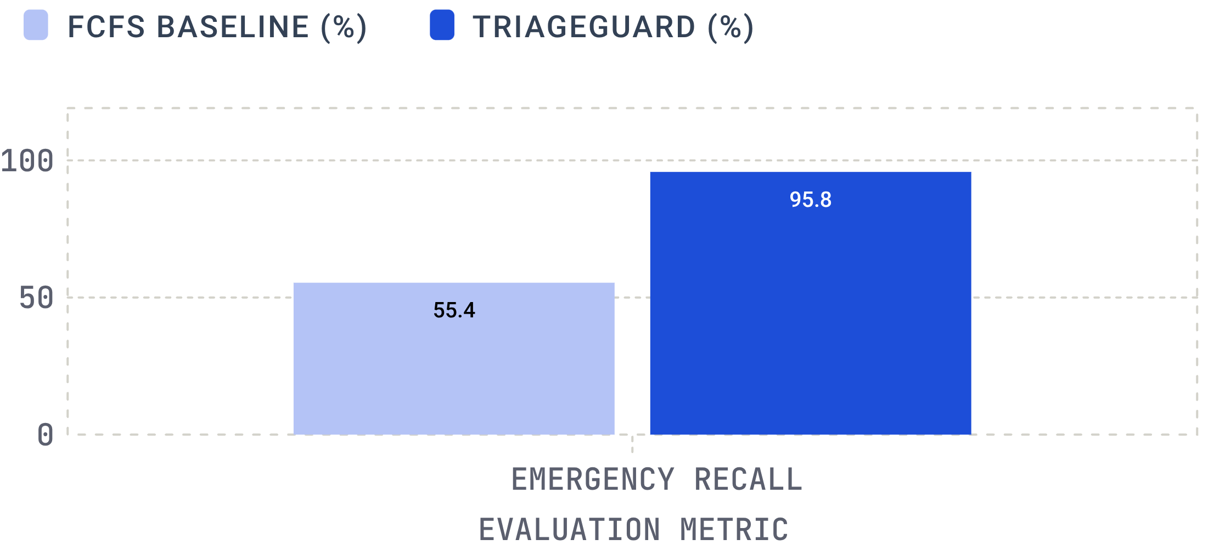
Reported simulation impact versus FCFS
CRITICAL SIMULATION DELTAS
−99.2%
EMERGENCY WAIT DURATION
Saved 35.2 minutes on average per emergency patient.
−54.5%
Official Phase 2: primary scorer 0.6390 versus 0.4645; red-flag F1 0.6561.
HARM-WEIGHTED WAIT
Relative gain of 72.9% in emergency recall over baseline.
SOURCE: DISCRETE-EVENT SIMULATION ON 30,327 PATIENTS ACROSS 38 OPERATING DAYS (10 REPLICATIONS). REPORTED EVALUATION RESULTS, NOT DEPLOYED CLINICAL OUTCOMES.
Notes:
Present the discrete-event simulation results across 30,327 encounters. Contrast the 55.4% baseline emergency detection with TriageGuard's 95.8% recall on official Phase 2 data. Clarify that these are reported simulation and evaluation results, not evidence of clinical deployment outcomes.

Slide 5
Hypoxia triggers a rapid escalation
EDGE AUDIT TRAIL · DETERMINISTIC ESCALATION TIMELINE
T + 0.000 S · REGISTRATION
BENCHMARK DEMO ENCOUNTER
Intake stream received. Bilingual complaint text and device vitals ingest into edge buffer.
Vikram S., 62M
Acute presentation: severe breathlessness and cough
VITAL SIGN | VALUE
BLOOD PRESSURE | 118/74 mmHg
HEART RATE | 98 bpm
BODY TEMPERATURE | 37.2 °C
SPO2 SATURATION | 88% (Hypoxic)
T + 0.003 S · DATA SANITISER
Vitals validated. 88% SpO2 verified as physiologically plausible; sensor malfunction excluded.
T + 0.006 S · SAFETY RULE R002 FIRED
Hard rule override. Critical hypoxia threshold (<90% SpO2) triggers immediate escalation protocol.
System latency: 12.8 ms on edge CPU without cloud network connectivity.
T + 0.012 S · DISPATCH DETERMINATION
ESI Level 1 Fast-Track. Bypasses registration queue; directs bedside oxygen and emergency casualty transfer.
Notes:
Walk through the trace of demo patient Vikram S. Showing an SpO2 of 88%, trace the sub-15ms execution step by step: ingestion at 0ms, validation at 3ms, rule R002 firing at 6ms, and the ESI Level 1 assignment at 12ms. Emphasize that the rule net made this decision without relying on black-box probabilistic output.

Slide 6

Two channels feed a safety-gated routing engine
CHANNEL 01 · PHYSIOLOGY STREAM
Monotone-Constrained LightGBM
adapt_schema() and clean_record() preprocess inputs. Physiological derangement cannot decrease predicted acuity.
CHANNEL 02 · CLINICAL LANGUAGE STREAM
Character n-gram TF-IDF + Logistic Regression
Handles spelling variants, dialect shifts and Hinglish complaints; evaluates 30 official red flags without cloud LLM dependencies.
FUSION & SAFETY GATE
5-Fold Out-of-Fold Stacker
PYTHON 3.12 · FASTAPI · UVICORN · LIGHTGBM · SCIKIT-LEARN · NUMPY · SCIPY · SIMPY · PYTEST
Platt calibration (ECE 0.005) and Mondrian screen (τ 0.0613; α 0.01) gate uncertain outputs for 13-department routing.
REPORTED: SUB-15MS · UNDER 5MB · 178 SAFETY TESTS PASSED
Notes:
Describe the dual-channel modeling strategy. Point out why monotonic constraints matter clinically: higher heart rates or lower oxygen saturations should never result in lower triage scores. Mention the low memory footprint under 5MB and the suite of 178 safety tests passed during the hackathon.

Slide 7
Safety rules make the decision auditable
CAPABILITY | STANDARD FCFS | BASIC ML TRIAGE | CLOUD LLM | TRIAGEGUARD
EMERGENCY RECALL | 55.4% | 72–80%* | 48.4%* | 95.8%
DETERMINISTIC HARD RULES | None | Rare | No | 13 ETAT + OB
SENSOR FAILURE DETECTION | Manual | Silent fail | Hallucinates | Auto-reject
AIR-GAPPED EDGE EXECUTION | N/A | Partial | No | Sub-15ms edge
WALK-IN OPD PRIORITISATION | None | Basic score | Uncalibrated | Dual routing
ASYMMETRIC RISK FORMULATION
20–50× Loss Penalty
The optimization loss function penalises false negatives (missed critical emergencies) up to 50 times more severely than false positives (precautionary over-triage).
CONFORMAL BOUNDS VS RECALL
Mondrian calibration targets 99% coverage under its modeling assumptions. The reported Phase 2 measured emergency recall reached 95.8%. Statistical coverage targets should not be conflated with unconditional real-world safety.
*COMPETITOR PERFORMANCE DATA REPRESENTS SUPPLIED BENCHMARK ASSERTIONS; NOT AN INDEPENDENT HEAD-TO-HEAD CLINICAL TRIAL.
Notes:
Explain the design behind auditability and asymmetric risk. Clarify the mathematical distinction between Mondrian conformal coverage and measured clinical recall. Walk through the competitor comparison table, being transparent that competitor figures reflect hackathon benchmark assertions rather than peer-reviewed head-to-head clinical trials.

Slide 8



Three failure modes and their safeguards
FAILURE MODE 01
FAILURE MODE 02
FAILURE MODE 03
Keyword Gaming & Exploitation
Corrupted Hardware Sensors
Hospital Network Outages
Patients or attendants might learn that shouting specific distress words fast-tracks their token.
Faulty pulse oximeters, loose cuffs, or dead probes produce erratic or zeroed digital readings.
Network loss can interrupt systems that rely on external connections.
ENGINEERING DEFENSE
ENGINEERING DEFENSE
Local execution needs no GPU or remote API; reported edge latency is 12.8ms. Offline inference does not itself solve power outages.
ENGINEERING DEFENSE
Implausible values are treated as missing. Two or more missing vitals trigger immediate nurse remeasurement.
Text red-flags enforce an acuity floor of ESI Level 3. Text alone cannot assign ESI Level 1 or 2.
Notes:
Break down the defensive architecture against three real-world hazards: malicious text manipulation, degraded physical diagnostic sensors, and intermittent hospital networking. Emphasize realistic boundaries, acknowledging that running offline protects against network drops but requires dedicated hospital power resilience.

Slide 9
From preparation to the official sprint
DIMENSION | PRE-SPRINT BASELINE | OFFICIAL HACKATHON BUILD
TRAINING DATA | 30,000 synthetic encounters | 21,455 official Phase 2 records + schema adapter
SAFETY NET | 13 standard WHO ETAT rules | Added obstetric danger protocols (BP ≥160/110 → OB/GYN Level 2)
RED-FLAG LEXICON | 10 basic clinical keywords | 30 standardized codes (Micro-F1 0.365 → 0.6561)
CALIBRATION SET | Uncalibrated raw probabilities | Official split (N=3,218), τ=0.0613, α=0.01; 95.8% reported recall
DISCRETE SIMULATION | Static queue approximations | 30,327 simulated patients, 38 days; 35.2 min saved per emergency patient
DEVELOPMENT VELOCITY
+79.8%
RED-FLAG F1 SCORE IMPROVEMENT
100%
SAFETY UNIT TESTS VERIFIED
178 unit and property tests verifying deterministic priority overrides.
Notes:
Summarize the progression from initial prototypes using synthetic data to the final hackathon submission. Highlight the integration of 21,455 official records, expanded obstetric safety rules to protect high-risk pregnancies, a tripling of clinical red-flag codes, and thorough validation via 178 automated tests.

Slide 10
Clinical evidence and public-health opportunity
SUPPLIED EVIDENCE CLAIMS
SUPPLIED MARKET ESTIMATES
764
Epic Sepsis Model: An audit reportedly missed 67% of cases.
DISTRICT HOSPITALS
ChatGPT: A 2026 Digital Health study reported 51.6% of acute emergencies missed.
612
GOVERNMENT MEDICAL COLLEGES
Counts and footfall estimates require verification.
Structured triage: A Malawi study reported mortality moving from 10–18% to 6–8%. An AIIMS study discusses nurse-led triage.
INTEGRATION STRATEGY
Complement eSanjeevani teleconsultation with physical casualty-door triage.
CLAIMS AND CONTEXT REQUIRE VERIFICATION BEFORE EXTERNAL USE.
Notes:
These are supplied evidence claims and market estimates, not independently verified conclusions. Verify the studies, their context, the counts and footfall estimates before external use.

